Slide 1
Home Template
Click to start presentation

Slide 2
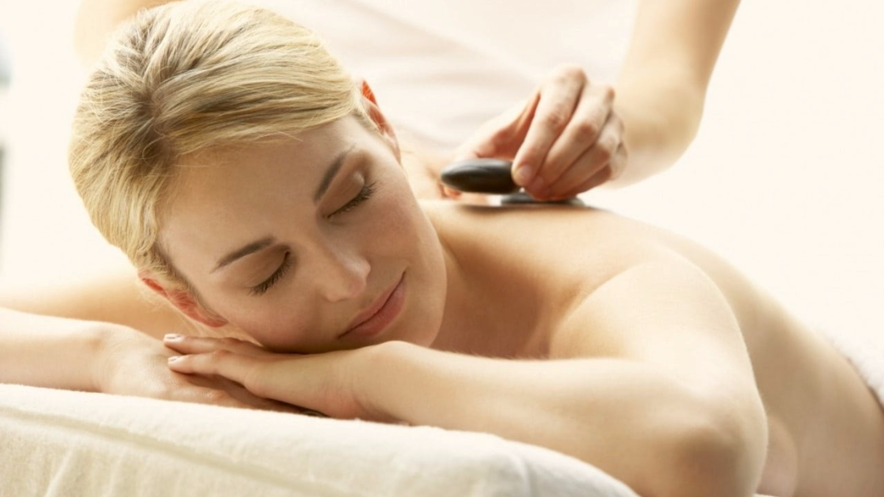

Home
Therapists
Book now
About us
Contacts
Join us
Sign in
Germany Mobile Spa
Relax. Rejuvenate. Renew.
Discover the healing power of touch. Our expert massage therapies not only melt away stress but also improve circulation, relieve muscle tension, and promote overall well-being. Invest in your health —because you deserve it.
Find your closest therapist

Slide 3
Home
Therapists
Book now
About us
Contacts
Join us
Sign in
Germany Mobile Spa
Relax. Rejuvenate. Renew.
Discover the healing power of touch. Our expert massage therapies not only melt away stress but also improve circulation, relieve muscle tension, and promote overall well-being. Invest in your health —because you deserve it.
Find your closest therapist

Slide 4

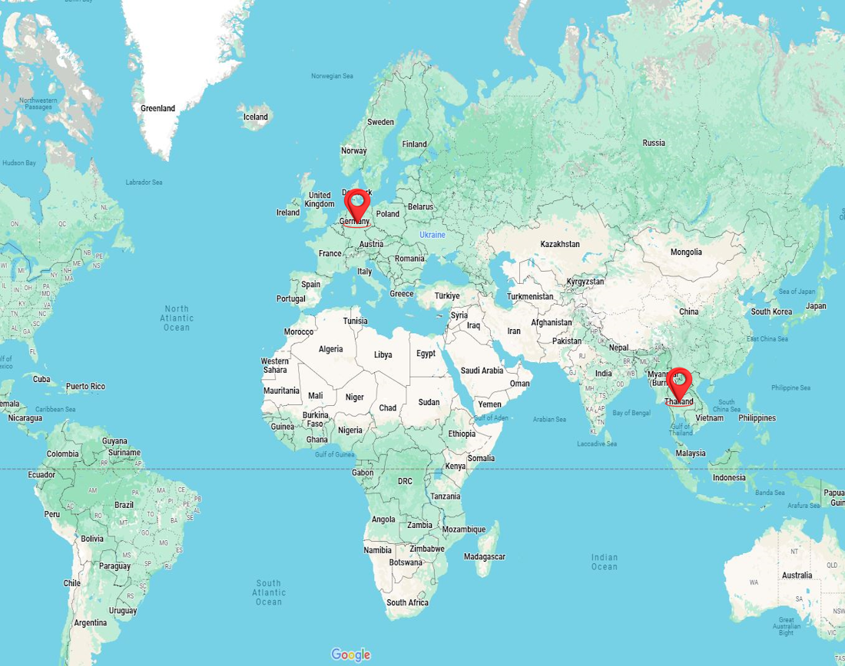
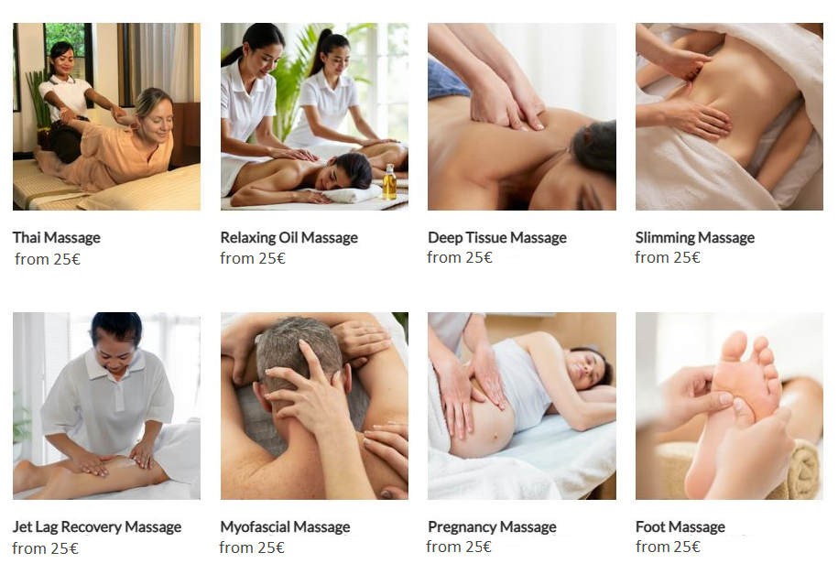
Home
Therapists
Book now
About us
Contacts
Join us
Sign in
Germany Mobile Spa
Relax. Rejuvenate. Renew.
Discover the healing power of touch. Our expert massage therapies not only melt away stress but also improve circulation, relieve muscle tension, and promote overall well-being. Invest in your health —because you deserve it.
Find your closest therapist
Enter your address
Choose a country
Choose a city
Services

Slide 5
We get a pop-up asking the user for access to their location
After pressing the button and going to the next part of this page
The next slides show what happens if the users says “No“ (Press to continue)

Slide 6

Relax. Rejuvenate. Renew.
Discover the healing power of touch. Our expert massage therapies not only melt away stress but also improve circulation, relieve muscle tension, and promote overall well-being. Invest in your health —because you deserve it.
Find your closest therapist
Home
Therapists
Book now
About us
Contacts
Join us
Sign in
Germany Mobile Spa
Enter your address
Choose a country
Choose a city
Services

Slide 7
Relax. Rejuvenate. Renew.
Discover the healing power of touch. Our expert massage therapies not only melt away stress but also improve circulation, relieve muscle tension, and promote overall well-being. Invest in your health —because you deserve it.
Find your closest therapist
Home
Therapists
Book now
About us
Contacts
Join us
Sign in
Germany Mobile Spa
Enter your address
Choose a country
Choose a city
Services

Slide 8


Relax. Rejuvenate. Renew.
Discover the healing power of touch. Our expert massage therapies not only melt away stress but also improve circulation, relieve muscle tension, and promote overall well-being. Invest in your health —because you deserve it.
Find your closest therapist
Home
Therapists
Book now
About us
Contacts
Join us
Sign in
Germany Mobile Spa
Enter your address
Choose a country
Germany
Choose a city
Choose a city
Services
Thailand
Services

Slide 9
Relax. Rejuvenate. Renew.
Discover the healing power of touch. Our expert massage therapies not only melt away stress but also improve circulation, relieve muscle tension, and promote overall well-being. Invest in your health —because you deserve it.
Find your closest therapist
Home
Therapists
Book now
About us
Contacts
Join us
Sign in
Germany Mobile Spa
Enter your address
Choose a country
Germany
Choose a city
Choose a city
Services
Thailand
Services

Slide 10
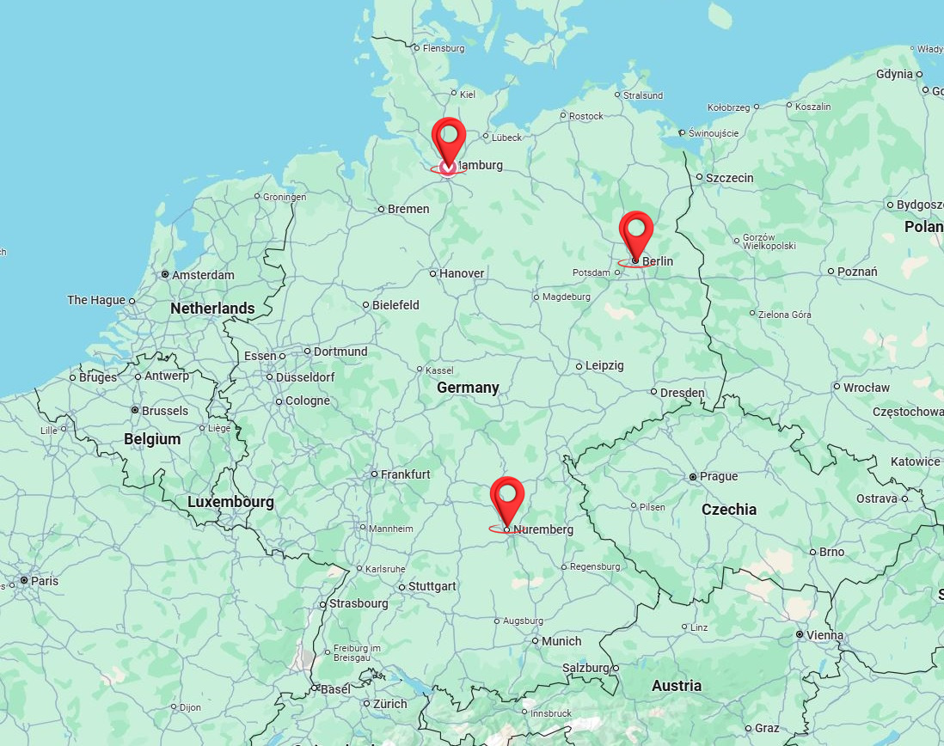
Relax. Rejuvenate. Renew.
Discover the healing power of touch. Our expert massage therapies not only melt away stress but also improve circulation, relieve muscle tension, and promote overall well-being. Invest in your health —because you deserve it.
Find your closest therapist
Home
Therapists
Book now
About us
Contacts
Join us
Sign in
Germany Mobile Spa
Enter your address
Germany
Choose a city
Services

Slide 11
Home
Therapists
Book now
About us
Contacts
Join us
Sign in
Germany Mobile Spa
Enter your address
Germany
Choose a city
Services

Slide 12
Home
Therapists
Book now
About us
Contacts
Join us
Sign in
Germany Mobile Spa
Enter your address
Germany
Choose a city
Berlin
Services
Hamburg
Stuttgard

Slide 13
Home
Therapists
Book now
About us
Contacts
Join us
Sign in
Germany Mobile Spa
Enter your address
Germany
Choose a city
Berlin
Services
Hamburg
Stuttgard

Slide 14
Home
Therapists
Book now
About us
Contacts
Join us
Sign in
Germany Mobile Spa
Enter your address
Germany
Berlin
Services

Slide 15
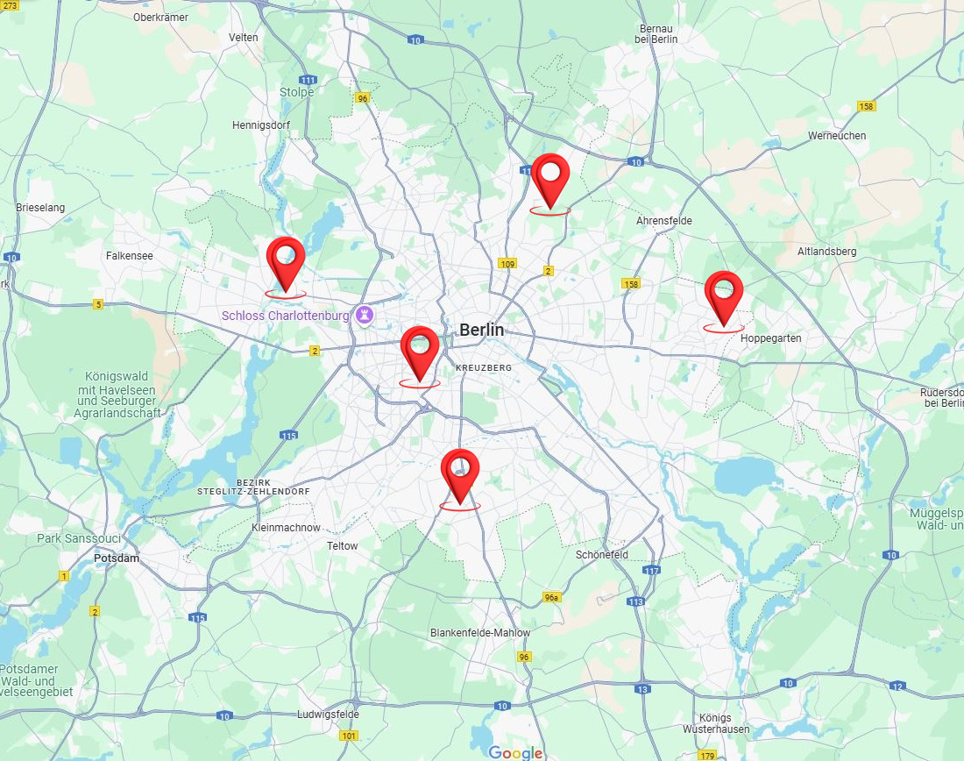
Home
Therapists
Book now
About us
Contacts
Join us
Sign in
Germany Mobile Spa
Enter your address
Germany
Berlin
Services

Slide 16
Home
Therapists
Book now
About us
Contacts
Join us
Sign in
Germany Mobile Spa
Enter your address
Germany
Berlin
Services

Slide 17
Home
Therapists
Book now
About us
Contacts
Join us
Sign in
Germany Mobile Spa
Enter your address
Germany
Berlin
Services

Slide 18
Home
Therapists
Book now
About us
Contacts
Join us
Sign in
Germany Mobile Spa
Enter your address
Germany
Berlin
Services

Slide 19
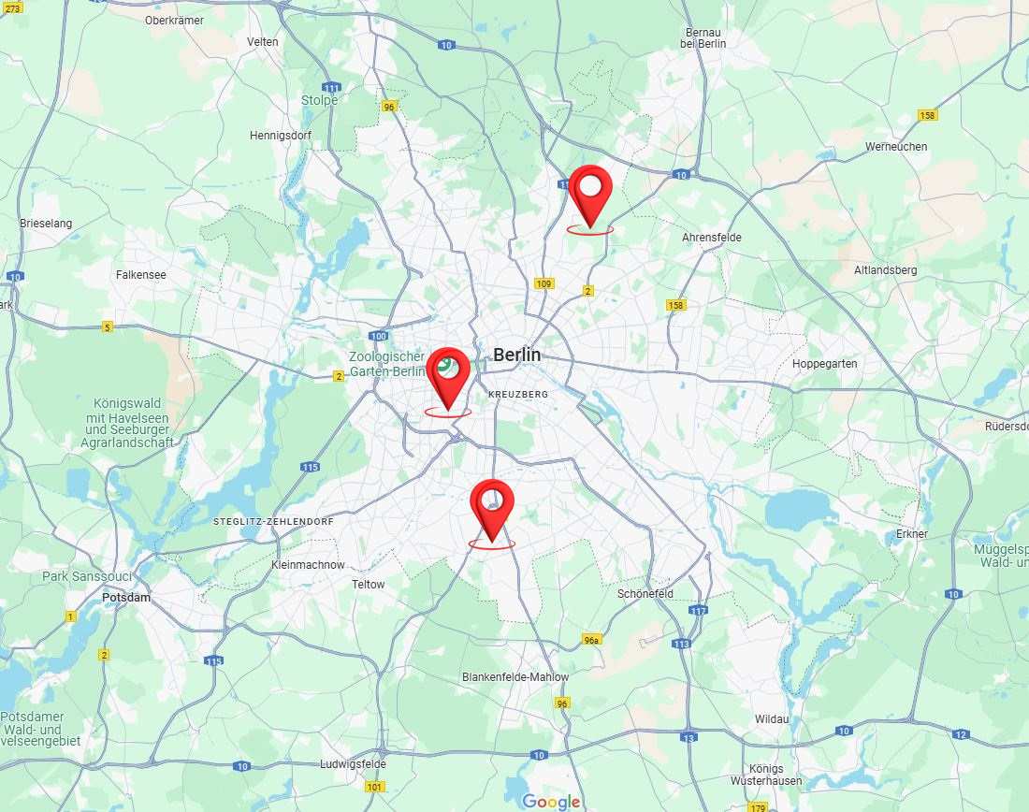
Home
Therapists
Book now
About us
Contacts
Join us
Sign in
Germany Mobile Spa
Enter your address
Germany
Berlin
Services
Discover the Benefits of Massage Therapy:
Relieves stress and anxiety
Eases muscle tension and pain
Improves circulation and flexibility
Boosts immune function and mental clarity
Why Choose Us? At [Your Business Name], we combine skill, care, and a serene environment to provide you with the ultimate relaxation experience. Our certified therapists customize each session to your needs, helping you unwind, rejuvenate, and restore balance.
Rechtliches
Impressum AGB Widerruf Datenschutz Versand
float HafenCity
Am Kaiserkai 42 20457 Hamburg Tel: 040 / 70 38 37 30 hafencity@float-hamburg.com
tägl. 10:00 – 22:00 Uhr
float Neustadt
Alter Steinweg 1 20459 Hamburg Tel: 040 / 36 93 54 64 neustadt@float-hamburg.com
tägl. 10:00 – 22:00 Uhr
float Rotherbaum
Mittelweg 160 20148 Hamburg Tel: 040 / 21 00 69 89 rotherbaum@float-hamburg.com
tägl. 10:00 – 22:00 Uhr
© 2024 [Your Business Name]. All rights reserved.
Follow us: [Social Media Icons]

Slide 20
We get a pop-up asking the user for access to their location
The next slides show what happens if the users says “Yes“ (Press to continue)

Slide 21
Enter your address
Germany
Berlin
Services
Home
Therapists
Book now
About us
Contacts
Join us
Sign in
Germany Mobile Spa
Discover the Benefits of Massage Therapy:
Relieves stress and anxiety
Eases muscle tension and pain
Improves circulation and flexibility
Boosts immune function and mental clarity
Why Choose Us? At [Your Business Name], we combine skill, care, and a serene environment to provide you with the ultimate relaxation experience. Our certified therapists customize each session to your needs, helping you unwind, rejuvenate, and restore balance.
Rechtliches
Impressum AGB Widerruf Datenschutz Versand
float HafenCity
Am Kaiserkai 42 20457 Hamburg Tel: 040 / 70 38 37 30 hafencity@float-hamburg.com
tägl. 10:00 – 22:00 Uhr
float Neustadt
Alter Steinweg 1 20459 Hamburg Tel: 040 / 36 93 54 64 neustadt@float-hamburg.com
tägl. 10:00 – 22:00 Uhr
float Rotherbaum
Mittelweg 160 20148 Hamburg Tel: 040 / 21 00 69 89 rotherbaum@float-hamburg.com
tägl. 10:00 – 22:00 Uhr
© 2024 [Your Business Name]. All rights reserved.
Follow us: [Social Media Icons]

Slide 22
The end
Click to exit

